Slide 1






What's in the Harry Potter book
- Quiz 1-

Slide 2

Member
Unavailable Team
Rakchanok Thongkumpan
Kavin Singhakhet
Piyaboon Kunakornjittirak
Korrapin Pimapansri
6310422039
6310422040
6310422047
6220422056

Slide 3


QUIZ 1.1
"Count on Harry"

Slide 4



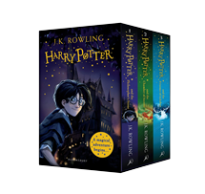



Word Count
1 line/s
File source
Streams-plain-text-input
Wordcount
("Harry")
5 seconds
Producer
Harry Potter.txt
Streams-wordcount-output
Subscribe
Client

Slide 5
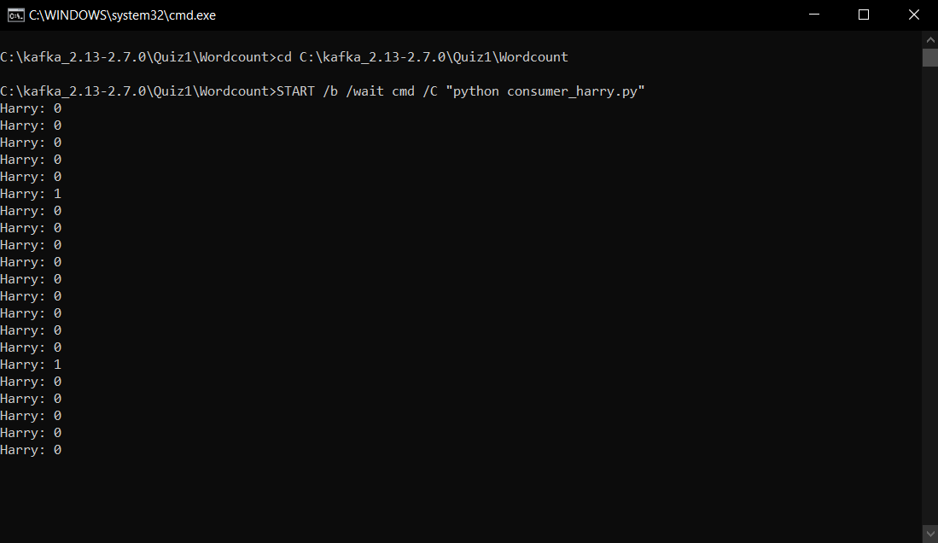
Word Count: Output

Slide 6

QUIZ 1.2
What's in the page

Slide 7




TF-IDF
File source
Topic 1
TF-IDF
Producer
Topic 2
Harry Potter.txt
Subscribe
Client

Slide 8
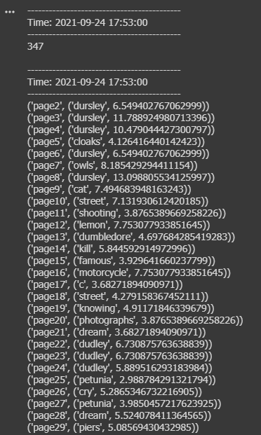
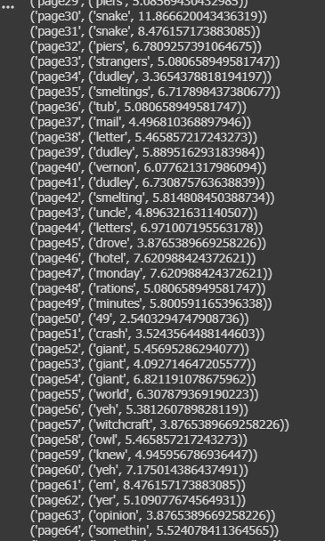
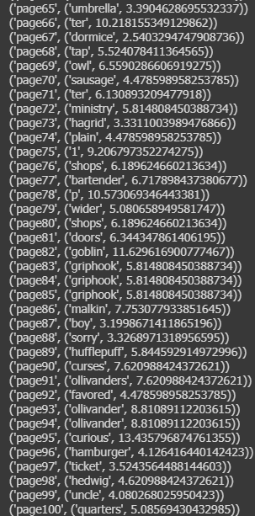
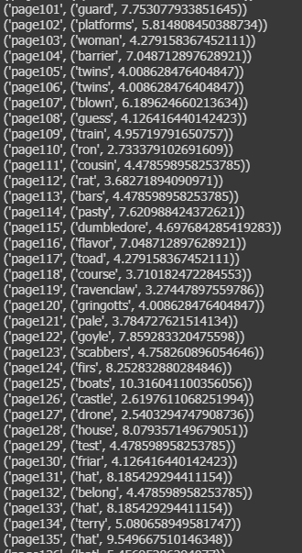
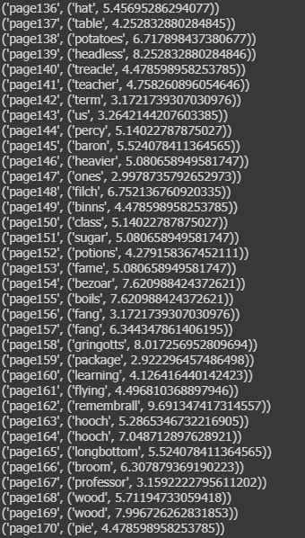
TF-IDF: Output

Slide 9


Demo

Slide 10
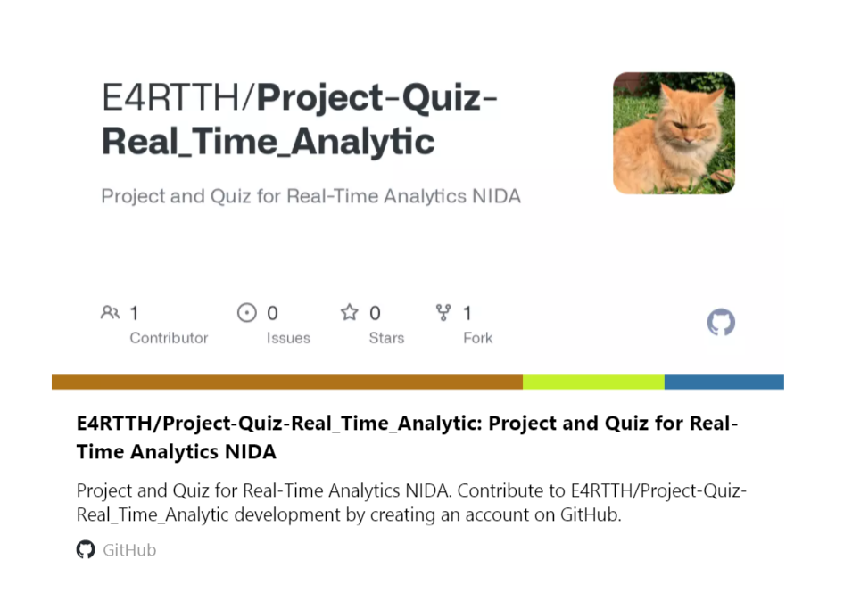

https://github.com/E4RTTH/Project-Quiz-Real_Time_Analytic/tree/main/Quiz%2001%20-%20Word%20count%20%26%20TF-IDF

Slide 11




Thank you!!

